Slide 1
Linear Regression
CSN-382

Slide 2
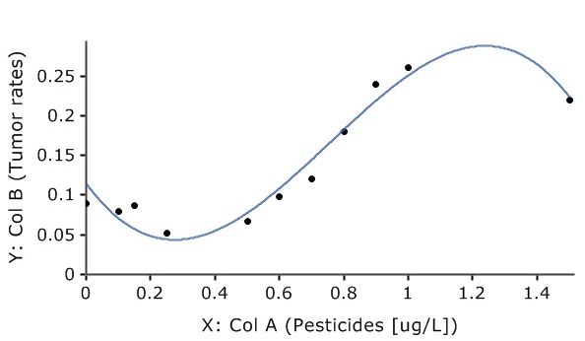
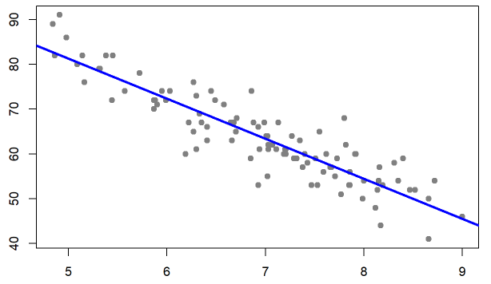
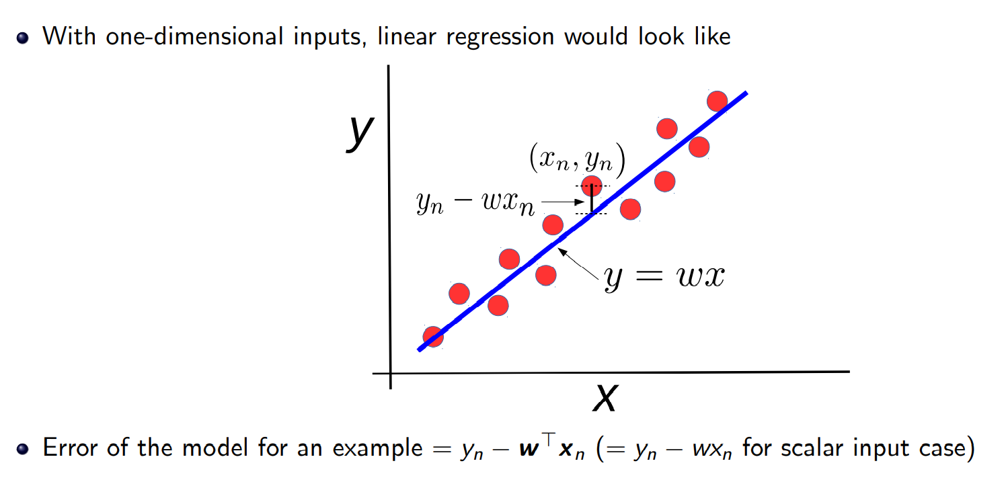
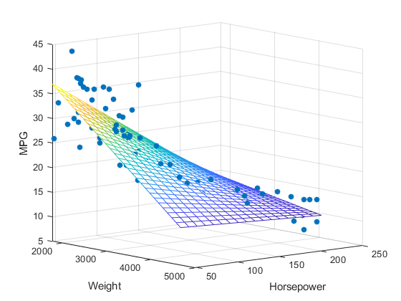



Regression: Pictorially
2
Regression: A supervised learning problem. Goal is to model the relationship between input (x) and real-valued output (y). This is akin to a line/plane or curve fitting problem
Linear Regression Polynomial Regression
(Output $y$)
(Output $y$)
(Feature 2)
(Feature 1)
Input $x$ (single feature)
Linear Regression
With one variable
Linear Regression
With multiple variables

Slide 3
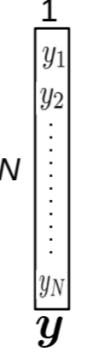
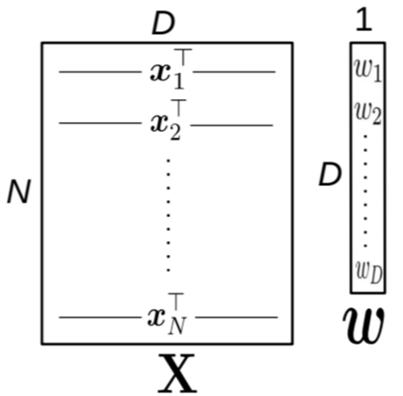

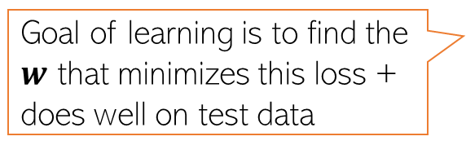

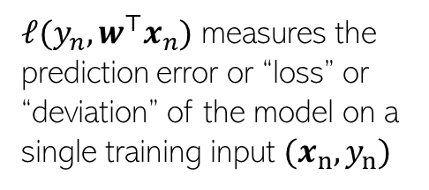
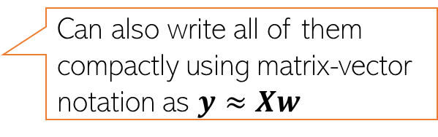
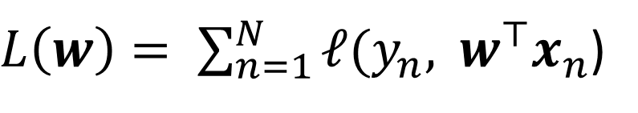
Linear Regression
3
Given: Training data with $N$ input-output pairs ${{\{(x}_{n},y_{n})\}}_{n=1}^{N}$, $x_{n}∈ℝ^{D}$, $y_{n}∈ℝ$
Goal: Learn a model to predict the output for new test inputs
Assume the function that approximates the I/O relationship to be a linear model
Let’s write the total error or “loss” of this model over the training data as
$$y_{n}≈f\left(x_{n}\right)= w^{⊤}x_{n} (n=1,2,…,N)$$
Can also write all of them compactly using matrix-vector notation as $y≈Xw$
Goal of learning is to find the $w$ that minimizes this loss + does well on test data
$L\left(w\right)= \sum_{n=1}^{N}{ℓ(y_{n}, }$ $w^{⊤}x_{n}$)
$ℓ(y_{n},w^{⊤}x_{n})$ measures the
prediction error or “loss” or “deviation” of the model on a single training input ${(x}_{n},y_{n})$
Unlike models like KNN and DT, here we have an explicit problem-specific objective (loss function) that we wish to optimize for

Slide 4
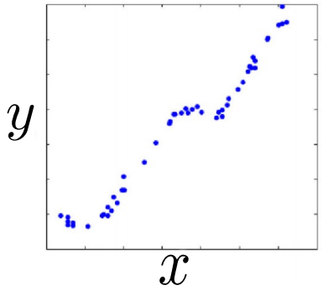
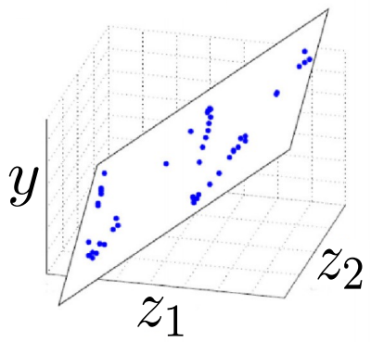




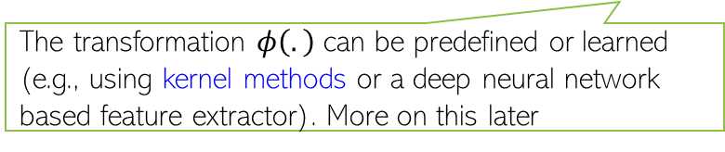

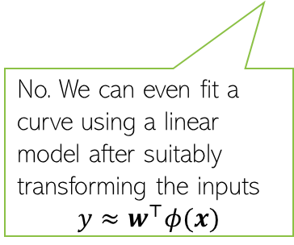
Linear Regression: Pictorially
4
Linear regression is like fitting a line or (hyper)plane to a set of points
The line/plane must also predict outputs the unseen (test) inputs well
$$\left[\begin{aligned}z_{1} \\ z_{2}\end{aligned}\right]=φ(x)$$
What if a line/plane doesn’t model the input-output relationship very well, e.g., if their relationship is better modeled by a nonlinear curve or curved surface?
Original (single) feature
Nonlinear curve needed
Two features
Can fit a plane (linear)
(Output $y$)
(Output $y$)
Do linear models become useless in such cases?
No. We can even fit a curve using a linear model after suitably transforming the inputs
$$y≈w^{⊤}φ(x)$$
Input $x$ (single feature)
(Feature 2)
(Feature 1)
The transformation $φ\left(.\right)$ can be predefined or learned (e.g., using kernel methods or a deep neural network based feature extractor). More on this later

Slide 5
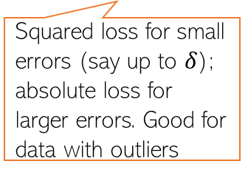


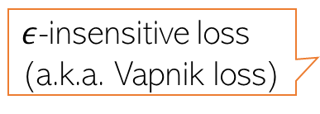









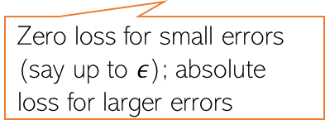
Loss Functions for Regression
5
Choice of loss function usually depends on the nature of the data. Also, some loss functions result in easier optimization problem than others
Many possible loss functions for regression problems
Squared loss
Loss
$${(y_{n}−f(x_{n}))}^{2}$$
Absolute loss
Loss
$${|y}_{n}−f\left(x_{n}\right)|$$
Very commonly used for regression. Leads to an easy-to-solve optimization problem
Grows more slowly than squared loss. Thus better suited when data has some outliers (inputs on which model makes large errors)
${y_{n}− f(x}_{n}$)
${y_{n}− f(x}_{n}$)
Loss
Huber loss
Loss
$${|y}_{n}−f\left(x_{n}\right)|−ε$$
Squared loss for small errors (say up to $δ$); absolute loss for larger errors. Good for data with outliers
$ε$-insensitive loss
(a.k.a. Vapnik loss)
Note: Can also use squared loss instead of absolute loss
Zero loss for small errors (say up to $ε$); absolute loss for larger errors
$$−δ$$
$$δ$$
${y_{n}− f(x}_{n}$)
$$−ε$$
$$ε$$
${y_{n}− f(x}_{n}$)

Slide 6
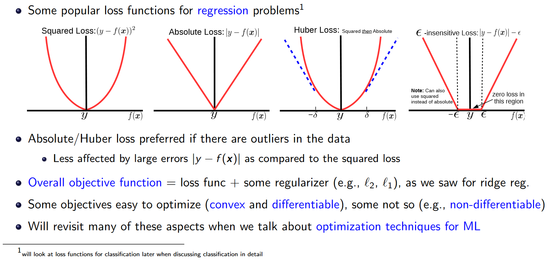
Loss Functions for Regression
6

Slide 7
Cost Function
Loss/Error function: Loss is calculated per observation, for each training example we see how much it deviated from the actual observation. Loss functions measure how far an estimated value is from its true value.
MAE (Mean absolute error), MSE (Mean Squared Error) are loss functions for regression problems
Binary Cross Entropy, Categorical Cross Entropy are loss functions associated with classification problems
https://towardsdatascience.com/common-loss-functions-in-machine-learning-46af0ffc4d23
https://www.enjoyalgorithms.com/blog/loss-and-cost-functions-in-machine-learning
Cost function: Cost is associated with the whole training data. A cost function is the average loss over the entire training dataset. It is a function that determines how well a Machine Learning model performs for a given set of data. Our aim in optimization is to minimize the cost function (using say Gradient Descent Optimizer) and get the optimal values of weights and biases.

Slide 8

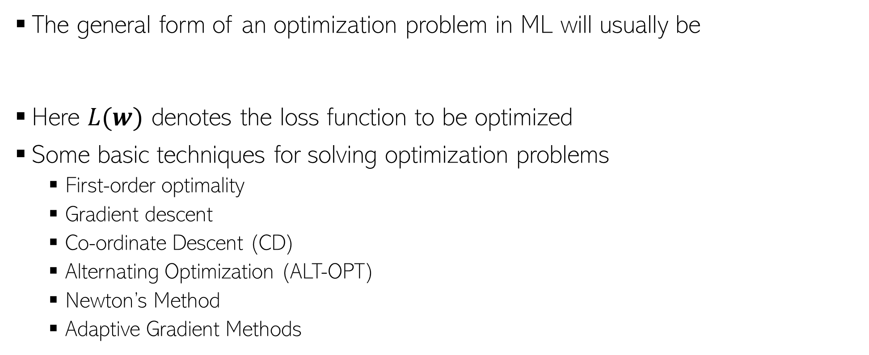
Loss/Cost Function Optimization
The general form of an optimization problem in ML will usually be
Here $L(w)$ denotes the loss function to be optimized
Some basic techniques for solving optimization problems
First-order optimality
Gradient descent
Co-ordinate Descent (CD)
Alternating Optimization (ALT-OPT)
Newton’s Method
Adaptive Gradient Methods
Usually a sum of the training error + regularizer
$w_{opt}= {arg min}_{w}$ $L(w)$
Will see optimization techniques in detail later

Slide 9

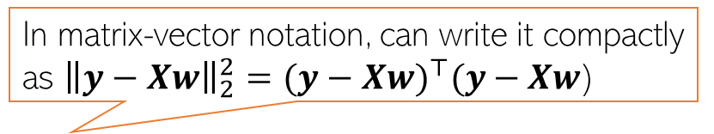
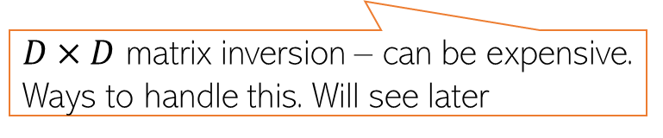
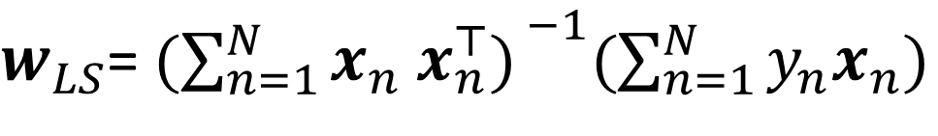


Linear Regression with Squared Loss
9
In matrix-vector notation, can write it compactly as ${\left\|y−Xw\right\|}_{2}^{2}={(y−Xw)}^{⊤}(y−Xw$)
In this case, the loss func will be
Let us find the $w$that optimizes (minimizes) the above squared loss
We need calculus and optimization to do this!
The LS problem can be solved easily and has a closed form solution
$L\left(w\right)=$ $\sum_{n=1}^{N}{{(y_{n}−w^{⊤}x_{n})}^{2}}$
The “least squares” (LS) problem Gauss-Legendre, 18th century)
Closed form solutions to ML problems are rare.
$w_{LS}$= ${\text{arg} \text{min}}_{w} L\left(w\right)={\text{arg} \text{min}}_{w}\sum_{n=1}^{N}{{(y_{n}−w^{⊤}x_{n})}^{2}}$
$w_{LS}$= ${(\sum_{n=1}^{N}{x_{n} x_{n}^{⊤}) }}^{−1}(\sum_{n=1}^{N}{y_{n}x_{n}})$
$${=(X^{⊤}X)}^{−1}X^{⊤}y$$
$D×D$ matrix inversion – can be expensive. Ways to handle this. Will see later

Slide 10

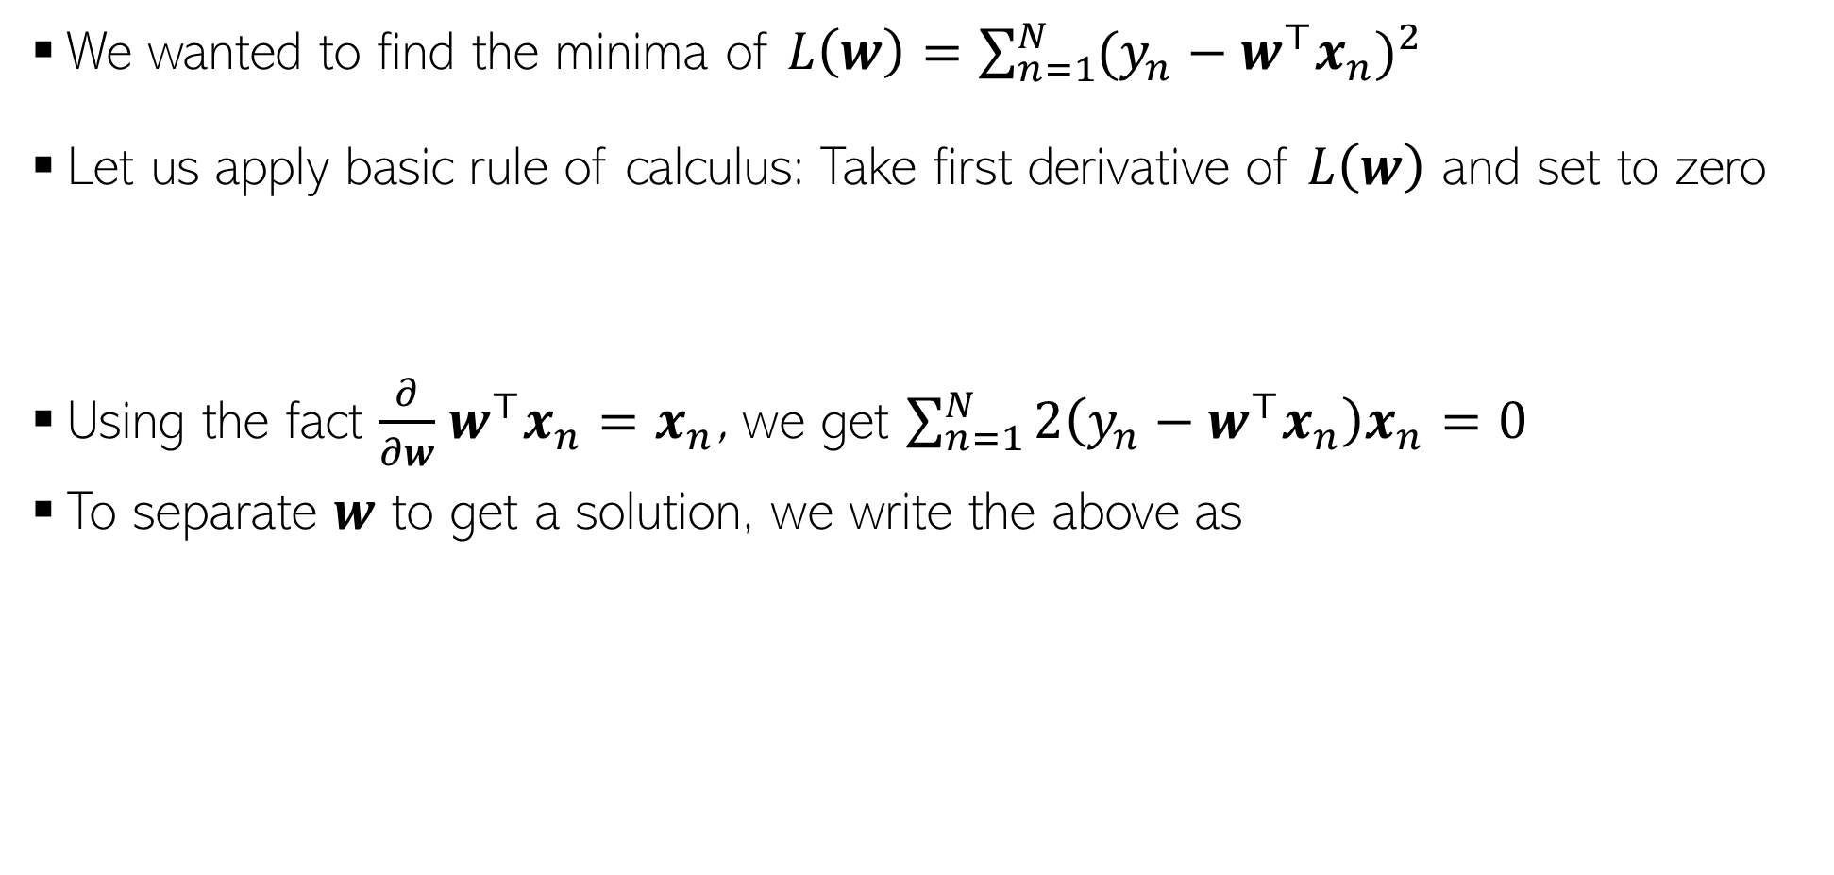
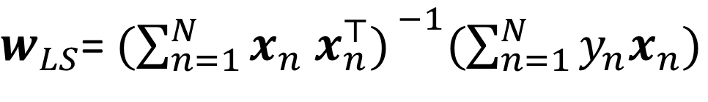

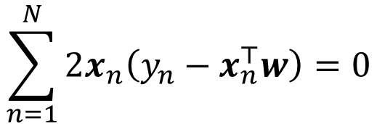

Proof: A bit of calculus/optim. (more on this later)
10
We wanted to find the minima of $L\left(w\right)=\sum_{n=1}^{N}{{(y_{n}−w^{⊤}x_{n})}^{2}}$
Let us apply basic rule of calculus: Take first derivative of $L\left(w\right)$ and set to zero
Using the fact $\frac{∂}{∂w}$ $w^{⊤}x_{n}=x_{n}$, we get $\sum_{n=1}^{N}{2\left(y_{n}−w^{⊤}x_{n}\right)x_{n}=0}$
To separate $w$ to get a solution, we write the above as
Chain rule of calculus
$\frac{∂L\left(w\right)}{∂w}=\frac{∂}{∂w}$ $\sum_{n=1}^{N}{{(y_{n}−w^{⊤}x_{n})}^{2}}=\sum_{n=1}^{N}{2\left(y_{n}−w^{⊤}x_{n}\right)\frac{∂}{∂w}}\left(y_{n}−w^{⊤}x_{n}\right)=0$
Partial derivative of dot product w.r.t each element of $w$
Result of this derivative is $x_{n}$ - same size as $w$
$$\sum_{n=1}^{N}{2x_{n}\left(y_{n}−x_{n}^{⊤}w\right)=0}$$
$$\sum_{n=1}^{N}{y_{n}x_{n}−x_{n}x_{n}^{⊤}w=0}$$
$w_{LS}$= ${(\sum_{n=1}^{N}{x_{n} x_{n}^{⊤}) }}^{−1}(\sum_{n=1}^{N}{y_{n}x_{n}})$
$${=(X^{⊤}X)}^{−1}X^{⊤}y$$

Slide 11
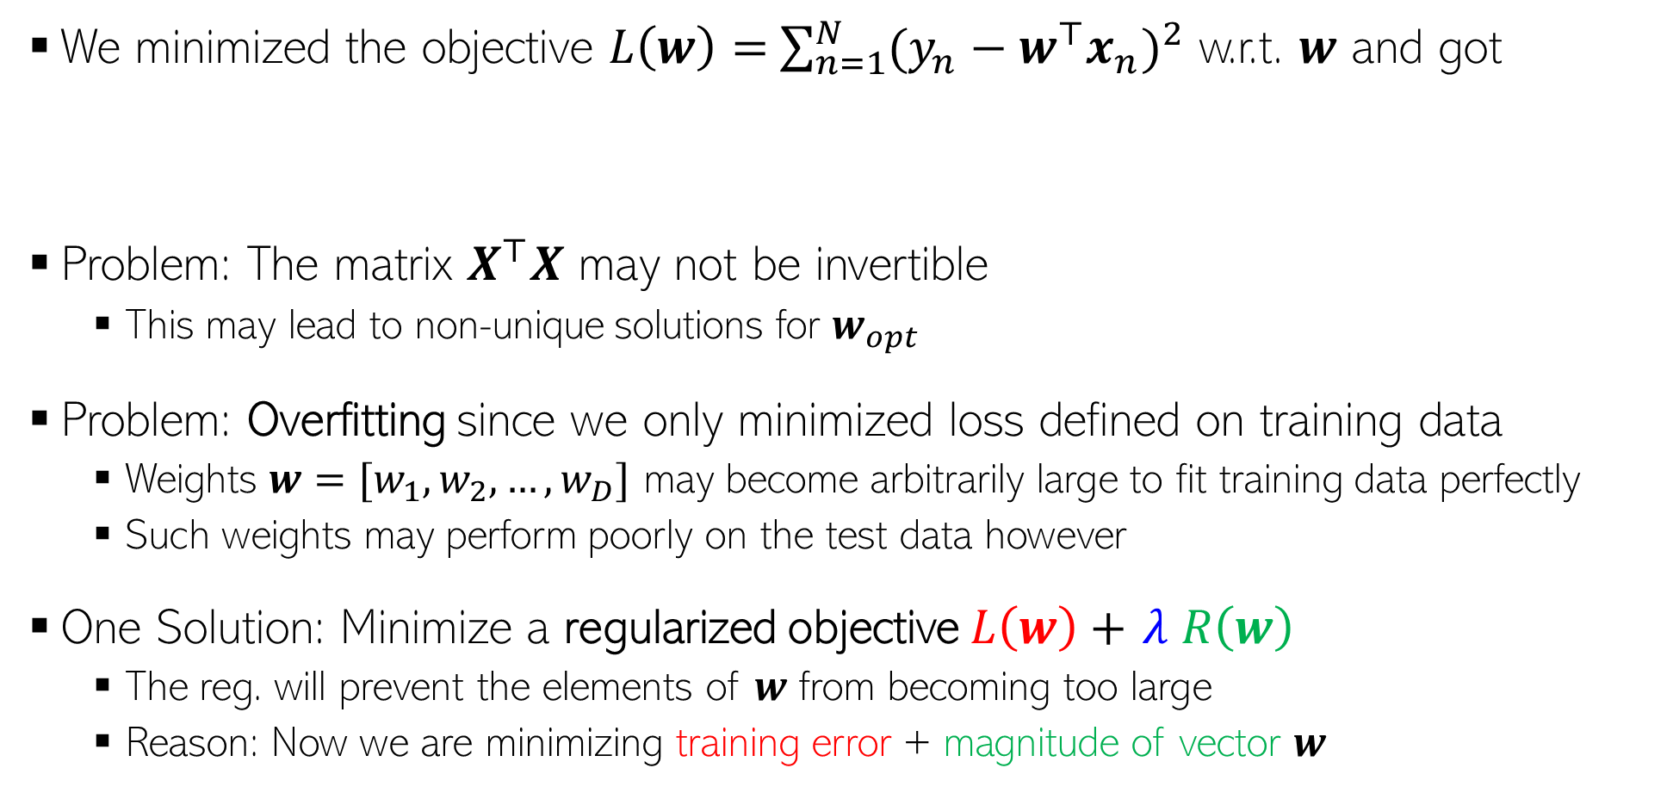
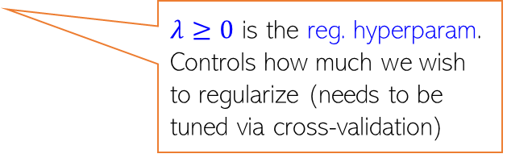
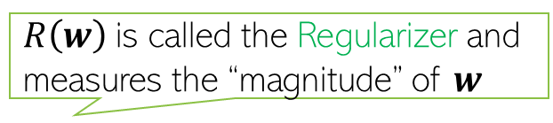

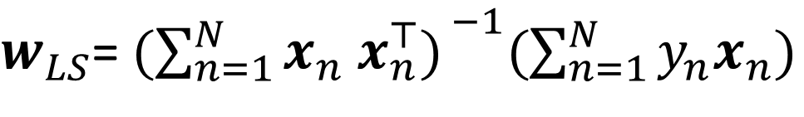
Problem(s) with the Solution!
11
We minimized the objective $L\left(w\right)=$ $\sum_{n=1}^{N}{{(y_{n}−w^{⊤}x_{n})}^{2}}$ w.r.t. $w$ and got
Problem: The matrix $X^{⊤}X$ may not be invertible
This may lead to non-unique solutions for $w_{opt}$
Problem: Overfitting since we only minimized loss defined on training data
Weights $w=[w_{1},w_{2},…,w_{D}]$ may become arbitrarily large to fit training data perfectly
Such weights may perform poorly on the test data however
One Solution: Minimize a regularized objective $L\left(w\right)+$ $λ R\left(w\right)$
The reg. will prevent the elements of $w$ from becoming too large
Reason: Now we are minimizing training error + magnitude of vector $w$
$w_{LS}$= ${(\sum_{n=1}^{N}{x_{n} x_{n}^{⊤}) }}^{−1}(\sum_{n=1}^{N}{y_{n}x_{n}})$
$${=(X^{⊤}X)}^{−1}X^{⊤}y$$
Two popular examples of regularization for linear regression are:
Ridge Regression or L2 Regularization
Lasso Regression or L1 Regularization
$R\left(w\right)$is called the Regularizer and measures the “magnitude” of $w$
$λ≥0$ is the reg. hyperparam. Controls how much we wish to regularize (needs to be tuned via cross-validation)

Slide 12
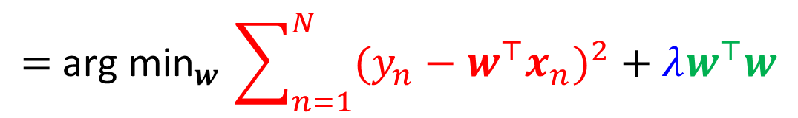
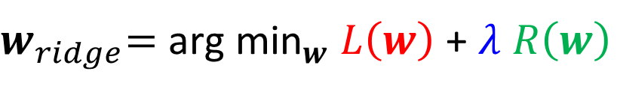
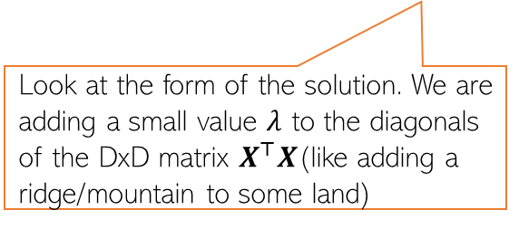

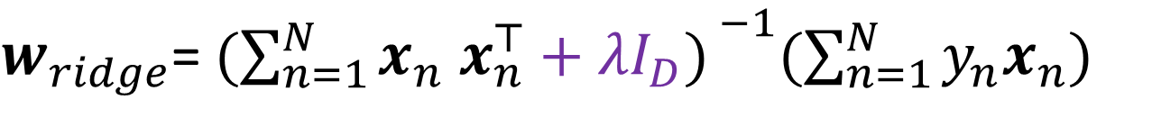


Regularized Least Squares (a.k.a. Ridge Regression)
Recall that the regularized objective is of the form $L_{reg}(w)= L\left(w\right)+λ R\left(w\right)$
One possible/popular regularizer: the squared Euclidean ($ℓ_{2}$ squared) norm of $w$
With this regularizer, we have the regularized least squares problem as
Proceeding just like the LS case, we can find the optimal $w$ which is given by
$$R\left(w\right)= {\left\|w\right\|}_{2}^{2}= w^{⊤}w$$
Look at the form of the solution. We are adding a small value $λ$ to the diagonals of the DxD matrix $X^{⊤}X$(like adding a ridge/mountain to some land)
$w_{ridge}\text{=} {\text{arg} \text{min}}_{w} L\left(w\right)$ + $λ R\left(w\right)$
$${\text{= }\text{arg} \text{min}}_{w}\sum_{n=1}^{N}{{(y_{n}−w^{⊤}x_{n})}^{2}}+λw^{⊤}w$$
Why is the method called “ridge” regression
$w_{ridge}$= ${(\sum_{n=1}^{N}{x_{n} x_{n}^{⊤}+λI_{D}) }}^{−1}(\sum_{n=1}^{N}{y_{n}x_{n}})$
$${=(X^{⊤}X+λI_{D})}^{−1}X^{⊤}y$$
Notes:
Also, it ensures that inversion is possible.
Also, overfitting will reduce.
Also, it will make the loss function strongly convex.

Slide 13



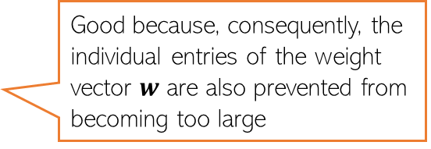

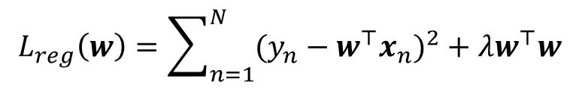



A closer look at $ℓ_{2}$ regularization
Remember – in general, weights with large magnitude are bad since they can cause overfitting on training data and may not work well on test data
The regularized objective we minimized is
Minimizing $L_{reg}\left(w\right)$w.r.t. $w$ gives a solution for $w$ that
Keeps the training error small
Has a small $ℓ_{2}$ squared norm $w^{⊤}w$ = $\sum_{d=1}^{D}{w_{d}^{2}}$
Small entries in $w$ are good since they lead to “smooth” models
$$L_{reg}\left(w\right)=\sum_{n=1}^{N}{{(y_{n}−w^{⊤}x_{n})}^{2}}+λw^{⊤}w$$
Good because, consequently, the individual entries of the weight vector $w$ are also prevented from becoming too large
Not a “smooth” model since its test data predictions may change drastically even with small changes in some feature’s value
A typical $w$ learned without $ℓ_{2}$ reg.
$$x_{n}=$$
1.2
0.5
2.4
0.3
0.8
0.1
0.9
2.1
$$y_{n}=0.8$$
3.2
1.8
1.3
2.1
10000
2.5
3.1
0.1
$$x_{m}=$$
$$y_{m}=100$$
1.2
0.5
2.4
0.3
0.8 $+ ε$
0.1
0.9
2.1
Just to fit the training data where one of the inputs was possibly an outlier, this weight became too big. Such a weight vector will possibly do poorly on normal test inputs
Exact same feature vectors only differing in just one feature by a small amount
Very different outputs though (maybe one of these two training ex. is an outlier)

Slide 14
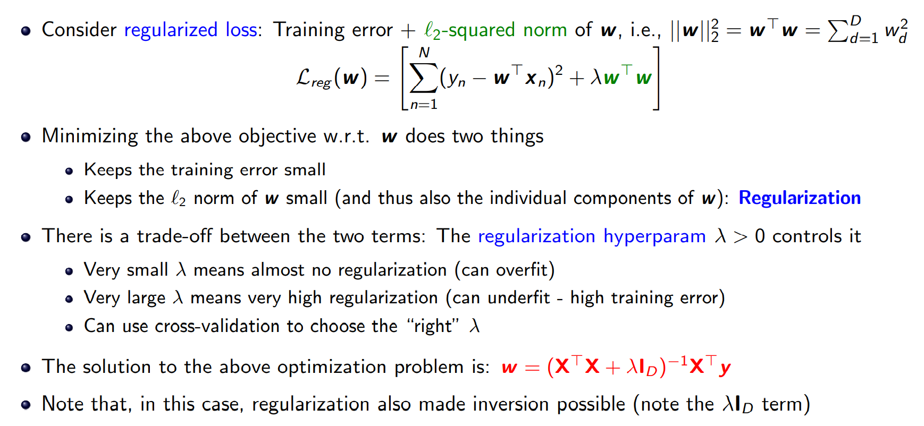
Regularized Least Squares (a.k.a. Ridge Regression)

Slide 15

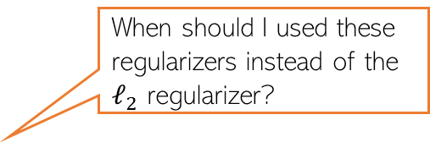
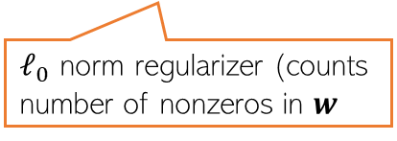



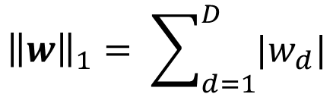
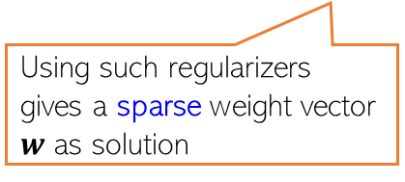
Other Ways to Control Overfitting
Note that optimizing loss functions with such regularizers is usually harder than ridge reg. but several advanced techniques exist (we will see some of those later)
Use a regularizer $R\left(w\right)$ defined by other norms, e.g.,
Use non-regularization based approaches
Early-stopping (stopping training just when we have a decent val. set accuracy)
Dropout (in each iteration, don’t update some of the weights)
Injecting noise in the inputs
$ℓ_{1}$ norm regularizer
Use them if you have a very large number of features but many irrelevant features. These regularizers can help in automatic feature selection
$${\left\|w\right\|}_{1}= \sum_{d=1}^{D}{|w_{d}|}$$
When should I used these regularizers instead of the $ℓ_{2}$ regularizer?
$${\left\|w\right\|}_{0}=\#nnz(w)$$
Using such regularizers gives a sparse weight vector $w$ as solution
sparse means many entries in $w$ will be zero or near zero. Thus those features will be considered irrelevant by the model and will not influence prediction
Automatic feature selection? Wow, cool!!!
But how exactly?
$ℓ_{0}$ norm regularizer (counts number of nonzeros in $w$
All of these are very popular ways to control overfitting in deep learning models. More on these later when we talk about deep learning

Slide 16
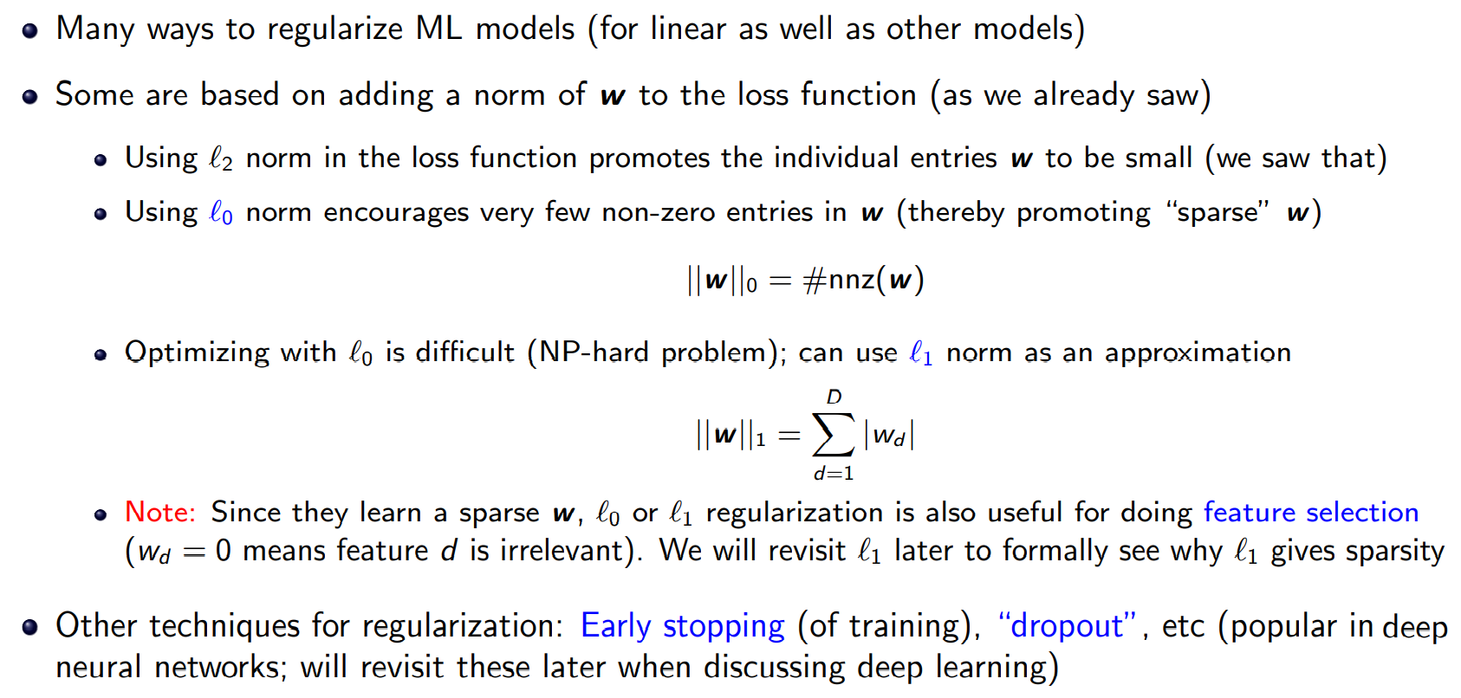
$ℓ_{0}$, $ℓ_{1}$, and $ℓ_{2}$ regularizations: Some Comments

Slide 17
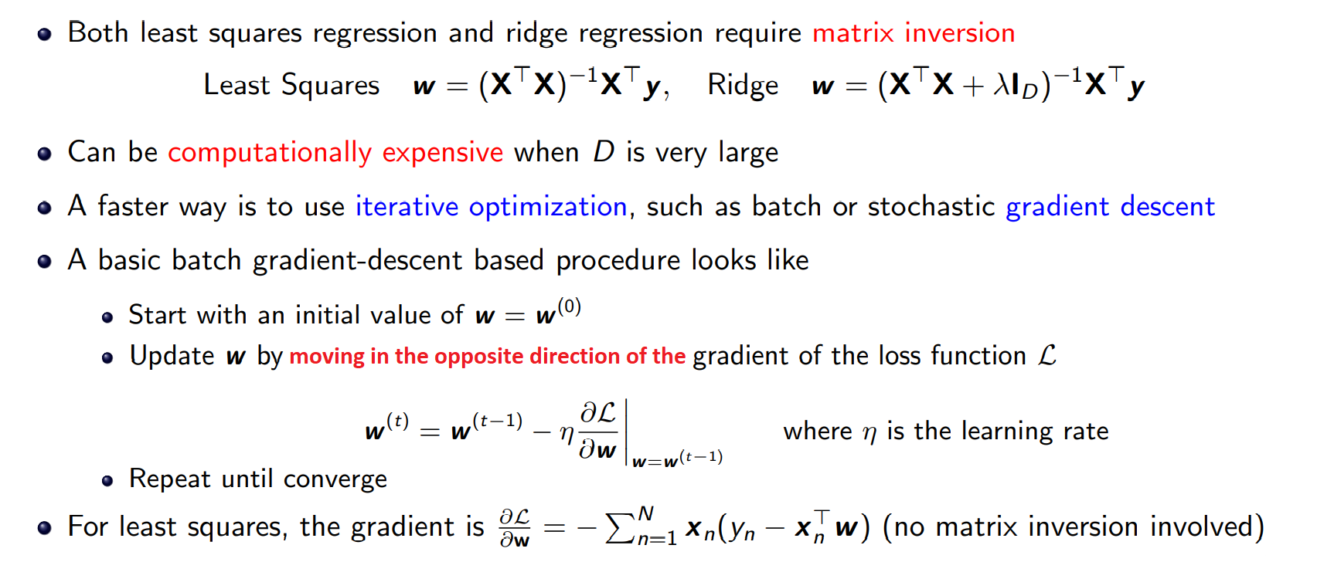
Linear/Ridge Regression via Gradient Descent
Such iterative methods for optimizing loss functions are widely used in ML. Will revisit these later in Detail

Slide 18
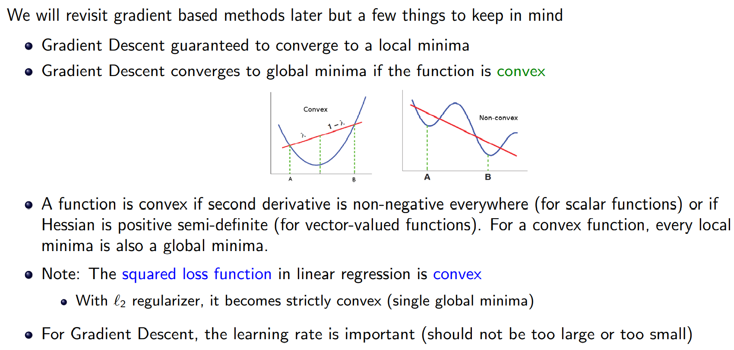
Linear/Ridge Regression via Gradient Descent

Slide 19







Linear Regression as Solving System of Linear Eqs
The form of the lin. reg. model $y≈Xw$ is akin to a system of linear equation
Assuming $N$ training examples with $D$ features each, we have
However, in regression, we rarely have $N=D$ but rather $N>D$ or $N<D$
Thus we have an underdetermined ($N<D$) or overdetermined ($N>D$) system
Methods to solve over/underdetermined systems can be used for lin-reg as well
Many of these methods don’t require expensive matrix inversion
First training example:
$$y_{1}=x_{11}w_{1}+x_{12}w_{2}+ …+x_{1D}w_{D}$$
Note: Here $x_{nd}$ denotes the $d^{th}$ feature of the $n^{th}$ training example
Second training example:
$$y_{2}=x_{21}w_{1}+x_{22}w_{2}+ …+x_{2D}w_{D}$$
$N$ equations and $D$ unknowns here ($w_{1},w_{2},…,w_{D}$)
N-th training example:
$$y_{N}=x_{N1}w_{1}+x_{N2}w_{2}+ …+x_{ND}w_{D}$$
Now solve this!
Solving lin-reg
as system of lin eq.
$$w{=(X^{⊤}X)}^{−1}X^{⊤}y$$
$Aw=b$ where ${A= X}^{⊤}X$, and ${b= X}^{⊤}y$
System of lin. Eqns with $D$ equations and $D$ unknowns

Slide 20
Linear and Polynomial Regression Implementations
https://ml-cheatsheet.readthedocs.io/en/latest/linear_regression.html
https://towardsdatascience.com/introduction-to-machine-learning-algorithms-linear-regression-14c4e325882a
https://www.edureka.co/blog/linear-regression-for-machine-learning/
https://www.analyticsvidhya.com/blog/2021/06/linear-regression-in-machine-learning/
https://towardsdatascience.com/polynomial-regression-bbe8b9d97491
https://www.analyticsvidhya.com/blog/2021/10/understanding-polynomial-regression-model/
https://www.coursera.org/lecture/machine-learning/features-and-polynomial-regression-Rqgfz
https://www.machinelearningworks.com/tutorials/polynomial-regression

Slide 21


Bias and Variance
Overfitting: The model fits the training set very well but fails to generalize to new examples. Overfitting happens when a model learns the detail and noise in the training data to the extent that it negatively impacts the performance of the model on new data. This means that the noise or random fluctuations in the training data is picked up and learned as concepts by the model. The problem is that these concepts do not apply to new data and negatively impact the models ability to generalize.
Underfitting: Underfitting refers to a model that can neither model the training data nor generalize to new data. An underfit machine learning model is not a suitable model and will be obvious as it will have poor performance on the training data.
Variance: Captures how much your classifier changes if you train on a different training set. How "over-specialized" is your classifier to a particular training set (overfitting)? If we have the best possible model for our training data, how far off are we from the average classifier? Bias: What is the inherent error that you obtain from your classifier even with infinite training data? This is due to your classifier being "biased" to a particular kind of solution (e.g. linear classifier). In other words, bias is inherent to your model.

Slide 22
Bias and Variance
Bias: The bias error is an error from erroneous assumptions in the learning algorithm. High bias can cause an algorithm to miss the relevant relations between features and target outputs (underfitting).
For example, in linear regression, the relationship between the X and the Y variable is assumed to be linear, when in reality the relationship may not be perfectly linear. You can expect an algorithm like linear regression to have high bias error, whereas an algorithm like decision tree has lower bias. Why? because decision trees don’t make such hard assumptions. So is the case with algorithms like k-Nearest Neighbours, etc.
Variance: The variance is an error from sensitivity to small fluctuations in the training set. High variance may result from an algorithm modeling the random noise in the training data (overfitting). The target function is estimated from the training data by a machine learning algorithm, so we should expect the algorithm to have some variance. Ideally, it should not change too much from one training dataset to the next, meaning that the algorithm is good at picking out the hidden underlying mapping between the inputs and the output variables. Machine learning algorithms with low variance are Linear Regression, Logistic Regression. Machine learning algorithms with high variance are decision tree, and K-nearest neighbours.
The bias–variance tradeoff is a central problem in supervised learning. Ideally, one wants to choose a model that both accurately captures the regularities in its training data, but also generalizes well to unseen data. Unfortunately, it is typically impossible to do both simultaneously. High-variance learning methods may be able to represent their training set well but are at risk of overfitting to noisy or unrepresentative training data. In contrast, algorithms with high bias typically produce simpler models that may fail to capture important regularities (i.e. underfit) in the data.

Slide 23




Slide 24


Slide 25


Slide 26


Slide 27


Slide 28


Slide 30

Bias Variance Tradeoffs
Models with low bias and low variance are golden but usually they exist only for specific domains (e.g. linear models may do very well in predicting income as a function of education). Expecting low variance and low bias in general is a pipe dream.
Two main sources of bad test performance for ML algos
Bias: model is too weak e.g. linear model for a very complex task
Even the best trained linear model is pathetic
Variance: model is strong but you could not train it properly e.g. NN
The best trained NN (Neural Network) is NP-hard to learn
Models with high variance usually are brittle as well
Changing training data even slightly changes the model parameters a lot
Usually models that are weak are also easy to train very accurately
In other words, they exhibit high bias, low variance
Usually models that are strong are more difficult to train too
In other words, they exhibit low-bias, high variance
Need to balance bias and variance in practice
Increasing the bias will decrease the variance.
Increasing the variance will decrease the bias.
Test Error
Error
Bias
Variance of most models goes down with more training data or else more effective optimization
Variance
Low
Medium
High
Model Complexity

Slide 31

Generalization Error
Generalization error (just like variance) can usually be brought down by using more data points or choosing models that are simpler
The gap between train and test error rates
Measures how well is the model+parameters able to “generalize” to unseen data
Gen error usually small for models with small complexity (small variance), high for models with high complexity (large variance)
Note: a model with large bias may give very good gen error but high test error
Its test error will be close to train error but both will be very large
Test/ValidationError
Difference between variance and gen error is subtle. Model complexity and train set size affect both. However, variance can also be high because of using an improper learning algorithm (or not optimizing properly) but usually algo issues do not affect gen error much.
Error
Underfitting
Overfitting
Gen Error
Training Error
Low
Medium
High
Model Complexity

Slide 32

Detecting Over/underfitting
Adding more data cannot decrease bias. The chosen model just sucks ☹ Adding more data can decrease variance though
Low training error but high test error??
You may have overfit – your model is simply memorizing training data
Your model is clearly powerful enough – does not seem to be a bias problem
Use more data/better optimizer/simpler model (or all) to decrease variance
High training error and high test error??
You may have underfit – your model is incapable of handling the learning task
Increase model class complexity, add better features, to decrease bias
Low training error and low test error
er … very good … moving on
High training error and low test error
Maybe you did early stopping which acted as a regularizer – lucky you!
Sometimes may need to iterate through the above experiences (experience high bias, reduce it only to increase variance, then decrease variance etc) before reaching a sweet spot
32

Slide 33
Next Lecture
Solving linear regression using iterative optimization (ex. Gradient Descent)methods
Faster and don’t require matrix inversion
Brief intro to optimization techniques

